Slide 1
NEUE FISCHE · CAPSTONE I · 2025/26
RAG The Research
With a knowledge-based AI Assistant
Thomas
Viktor
Markus

Slide 2

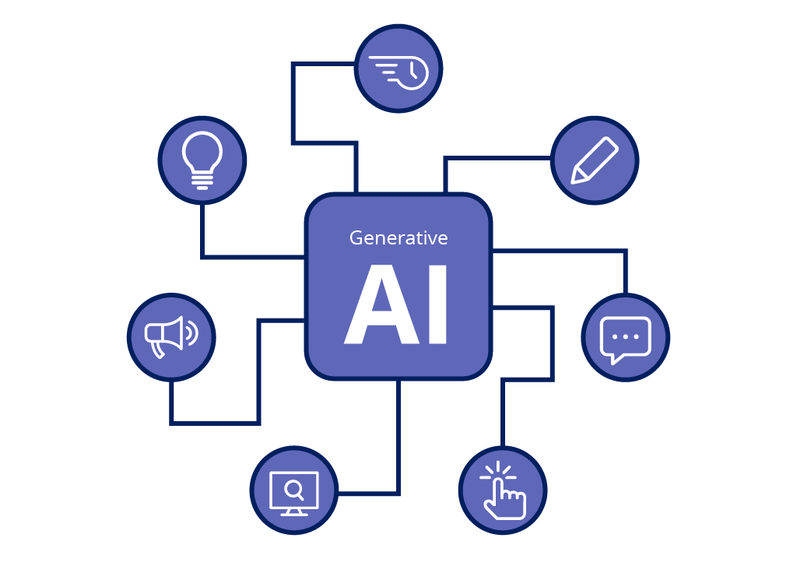
BRAVE NEW AI

Slide 3
WHEN YOU ASK AN LLM
You get:
Access to an immense amount of data
Reasoning capabilities
Context based answers
Summaries

Slide 4

WHEN YOU ASK AN LLM
You get:
Access to an immense amount of data
Reasoning capabilities
Context based answers
Summaries
End of Story?

Slide 5
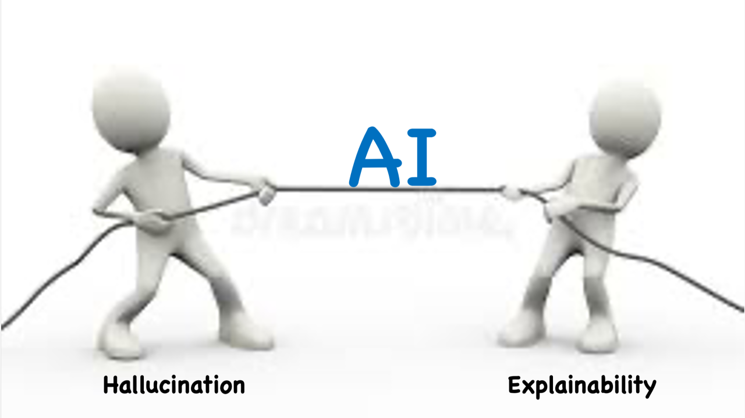
PROBLEM 1
Reliability

Slide 6

WHY IS RELIABILITY A PROBLEM FOR AI?
No Traceability, No Reliability

Slide 7

PROBLEM 2
Data Availability / Security

Slide 8
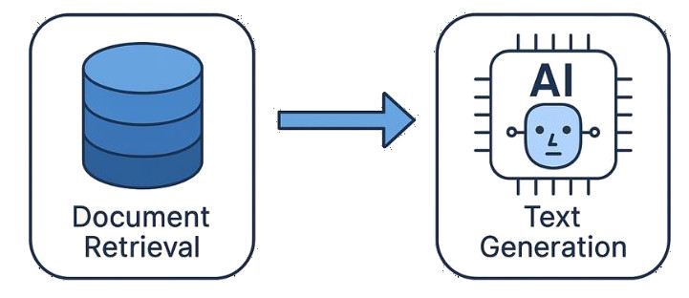
THE BEST OF ALL WORLDS
Retrieval Augmented Generation RAG

Slide 9


THE BEST OF ALL WORLDS
Retrieval Augmented Generation RAG

Slide 10
OUR GOAL
Building a Locally Running RAG from Scratch
Proof of concept for many business applications
Make sensitive data reliably accessible
Harness the capabilities of LLMs
  Semantic searching
  Conclusion Drawing
  Inconsistency detection

Slide 11

OUR USE CASE
The PubMed Scientific Database
National Library of Medicine (NIH), USA
Over 40 million citations and abstracts (since 1966)
10.9 million open access papers
Clinical studies, medicine, life sciences
Well curated
Available in XML

Slide 12
OUR USE CASE
The PubMed Scientific Database
National Library of Medicine (NIH), USA
Over 40 million citations and abstracts (since 1966)
10.9 million open access papers
Clinical studies, medicine, life sciences
Well curated
Available in XML
The PubMed Q&A Dataset
1000 Questions and Answers
Yes/No + Fulltext
Only 69 in Open Access

Slide 13

OUR DATA
Reduced to a Feasible Amount of Data
40 million PubMed paper
10 million open access paper
2.3 million paper for non-commercial use
10K paper in our data set (incl. 69 golden paper)

Slide 14
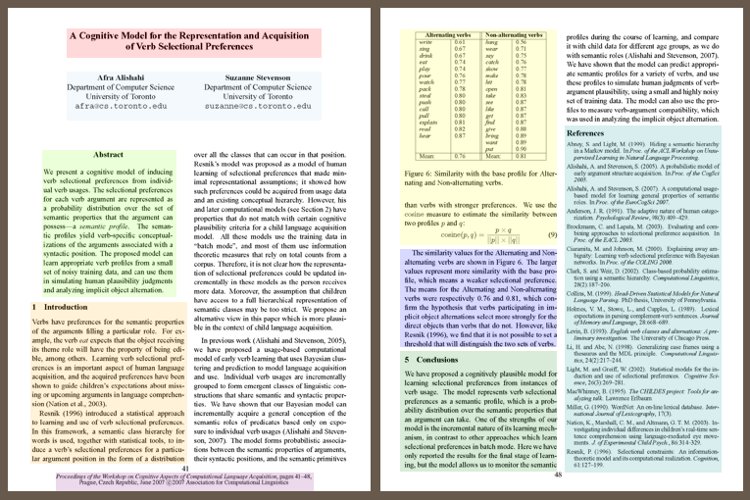
SCIENTIFIC PAPER
The Structure of Knowledge

Slide 15
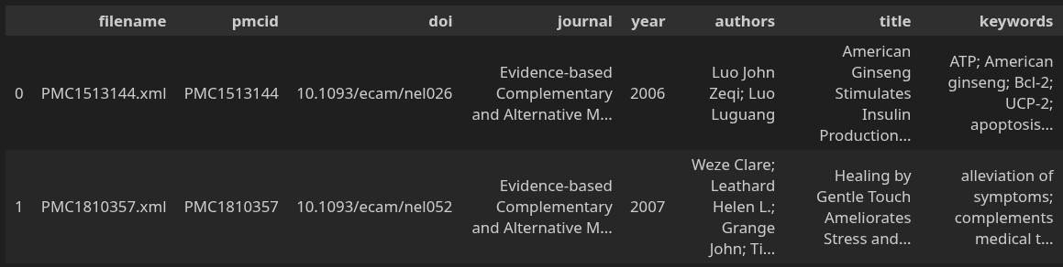
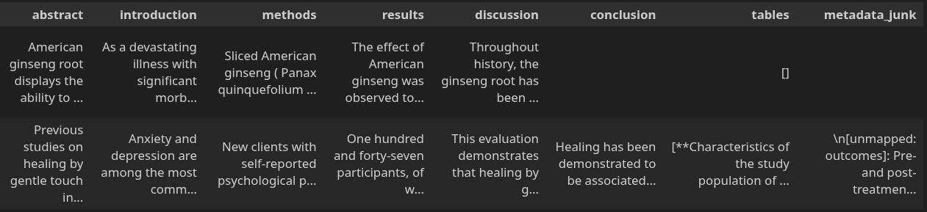
SCIENTIFIC PAPER
The Structure of the Data

Slide 16
From A
Clinical Question
To an Reliable Answer
- The Pipeline -
Viktor

Slide 17
HOW IT WORKS
The Pipeline — Clinical Question to Answer
Index built once offline (10,000 articles · 46,853 chunks)
Chunking
emmbedding
1
2a
2b
3
4
5
Query
Keyword
Search
+
Fusion
Top-K
Articles
LLM
Answer
Semantic
Search
plain-language
clinical question
tokenised ·
scored
against 46k chunks
both lists merged
· remove duplicates/deduping
highest-scoring
excerpts as context
cited answer · context
only · no general training
query embedded · biomedical
model · nearest-neighbour

